Slide 1


2024-25 Title l Annual Parent Meeting
September 19, 2024
5:30 PM
Cafeteria
Principal, Carlmon Jones
Notes:
Thank you for coming tonight to learn more about Title 1. Were so glad that you have joined us. Our goal is to provide information and to seek your input for success on our campus.
Evidence: Upload completed presentation and recorded feedback as part of the evidence to support the Annual Meeting Materials. Do not forget the sign-in sheets, and survey/feedback that you receive throughout the meeting.

Slide 2



All About Title l
Title I is the largest federal assistance program for our nation’s schools.
The program serves 99 schools in Pinellas County including eligible students in 39 non-public schools.
The Title l goal is that every student achieves high levels of academic proficiency.
Notes:
Highlight the Title l Program here in Pinellas County.

Slide 3

Title I Funding Process
2. Florida Department of Education
1. Federal Government
4. John Hopkins MS
3. Pinellas County Schools
Notes:
The Florida Department of Education receives funds from the federal government. Districts receive Title I funds from Department of Education, and the school district distributes these funds to schools based on the percentage of children eligible for free/reduced price lunch; however, students do not have to be from low-income families to receive help.

Slide 4
Title I Schoolwide Planning and Input
First
Second
Last
Please provide feedback so that we can assess how to meet your needs. Your input is valuable!
Please attend online or in-person meetings/trainings and complete surveys to provide input on Title I funding.
All Title I schools must document that parents are involved in the schoolwide planning process. We are always growing and changing to help our schools. Check out the calendar on our website for events. We want to see you!
Notes:
Your voice is a valuable part of our activities for student achievement. We invite you to provide feedback about any online trainings and in-person meetings and events that you attend so that we can work together to meet everyone's needs. Check out new and renovated calendar on our Hopkis website for opportunities to be with us on campus. We want to see you!
Evidence for input – input from school can be a survey or notes, which include quotes related to what was shared as feedback AND how this input will be used to inform the PFEP and future engagement activities.
Evidence of Attendance – please include attendance of DIVERSE stakeholder group/s.

Slide 5

Parent’s Right to Know
As a parent of a student attending a Pinellas County School Public School, you have the right to…
Be
Be provided information on your child’s level of achievement on assessments in Reading/Language Arts, Writing, Mathematics, and Science.
Request and receive information on the qualifications of your child’s teacher and supplemental personnel working with your child.
Be
Be notified of non-highly qualified or out-of-field teachers at the school.
Be
Be informed if your child is taught by a non-highly qualified teacher for four or more consecutive weeks.
Notes:
A right-to-know outline is provided on the Title 1 table.

Slide 6
Working Together for Student Success
School
School Improvement Plan (SIP)
Title
Title I Schoolwide Plan
Parent
Parent and Family Engagement Plan
School
School-Parent-Student Compact
Title l is now included as a part of the School Improvement Plan
https://www.pcsb.org/hopkins-ms
Notes:
As a Title I parent you have the right to be involved in the development of the School Improvement Plan, the Title 1 Schoolwide Plant, the Parent and Family Engagement Plan, the school-parent-student compact. These documents for our school can be found on our website pcsb.org/hopins-ms to view as well as in the Parent Station located in the lobby of the front office.

Slide 7


Parent-School-Student Compact
Please review and sign your child’s Compact.
Our goal is to receive 100% signed compacts!
The Parent-School-Student Compact is updated every year to include input from parents, students, teachers, and staff. Parent, student, teacher and staff comments are welcome at any time during the year.
Notes:
At the elementary level, school compacts are used as a progress monitoring tool through the year during parent teacher conferences.

Slide 8

Parent and Family Engagement Plan (PFEP)
The PFEP Sections include information about the following:
  Parent training to increase student achievement
  Staff training for engaging parents
  Communication methods between home and school
  Flexible meeting times
  Accessibility for parents
  Coordinating with other Federal Programs
  To access the full LEA PFEP, please visit
  www.pcsb.org/titleone
Notes:
Provide information on the specific committees that parents can be involved. Include the purpose, date and time of meetings.
Explain the PFEP and its purpose.
Consider the evidence related Title I Crate, Sample of Evidence,

Slide 9


Florida Benchmark For Excellent Student Thinking Standards (B.E.S.T). You may read more information at: www.fldoe.org
Notes:
All curriculum, instruction and assessments are based on student-centered expectations.

Slide 10

  School Report Cards
  School Grade and Overview
  Population and Enrollment
  Assessments – Academic Achievement, Growth, and Population
  Assessments – English Language Learners
  Graduation and Beyond
  Educator Qualifications and Equity
  Long-Term Goals and Interim Progress
  Accelerated Course Enrollment
  Per-Pupil Expenditures
  National Data
  Available online at https://edudata.fldoe.org/
  or in the Front Office
Notes:
School report cards are available at any time to duscuss **** edudata.FLDOE.org

Slide 11

Picture Day- September 24, 25
Reading Opens the World – September 28; 8:00 am and 2:00 pm.
FAST parent night – Coming In October
Notes:
Great things are happening at Hopkins. Among a few of the upcoming events are Picture day Sept 24,25. Reading Opens the World will be held on Saturday, September 28, between 8:00 am and 2:00 pm. It will be held on our campus. Pinellas Classroom Teachers Association will give away over 30,000 FREE books to students, families, educators, public employees, and healthcare professionals! This event is wonderful way to support children's learning journey and be a part of a community dedicated to making a difference through the power of reading!
To register, please scan the QR code on the calendar on our website
Join us for FAST parent night to see your childs Florida Assessment of Student Thinking scores and find out ways you can hep your child learn and grow.

Slide 12
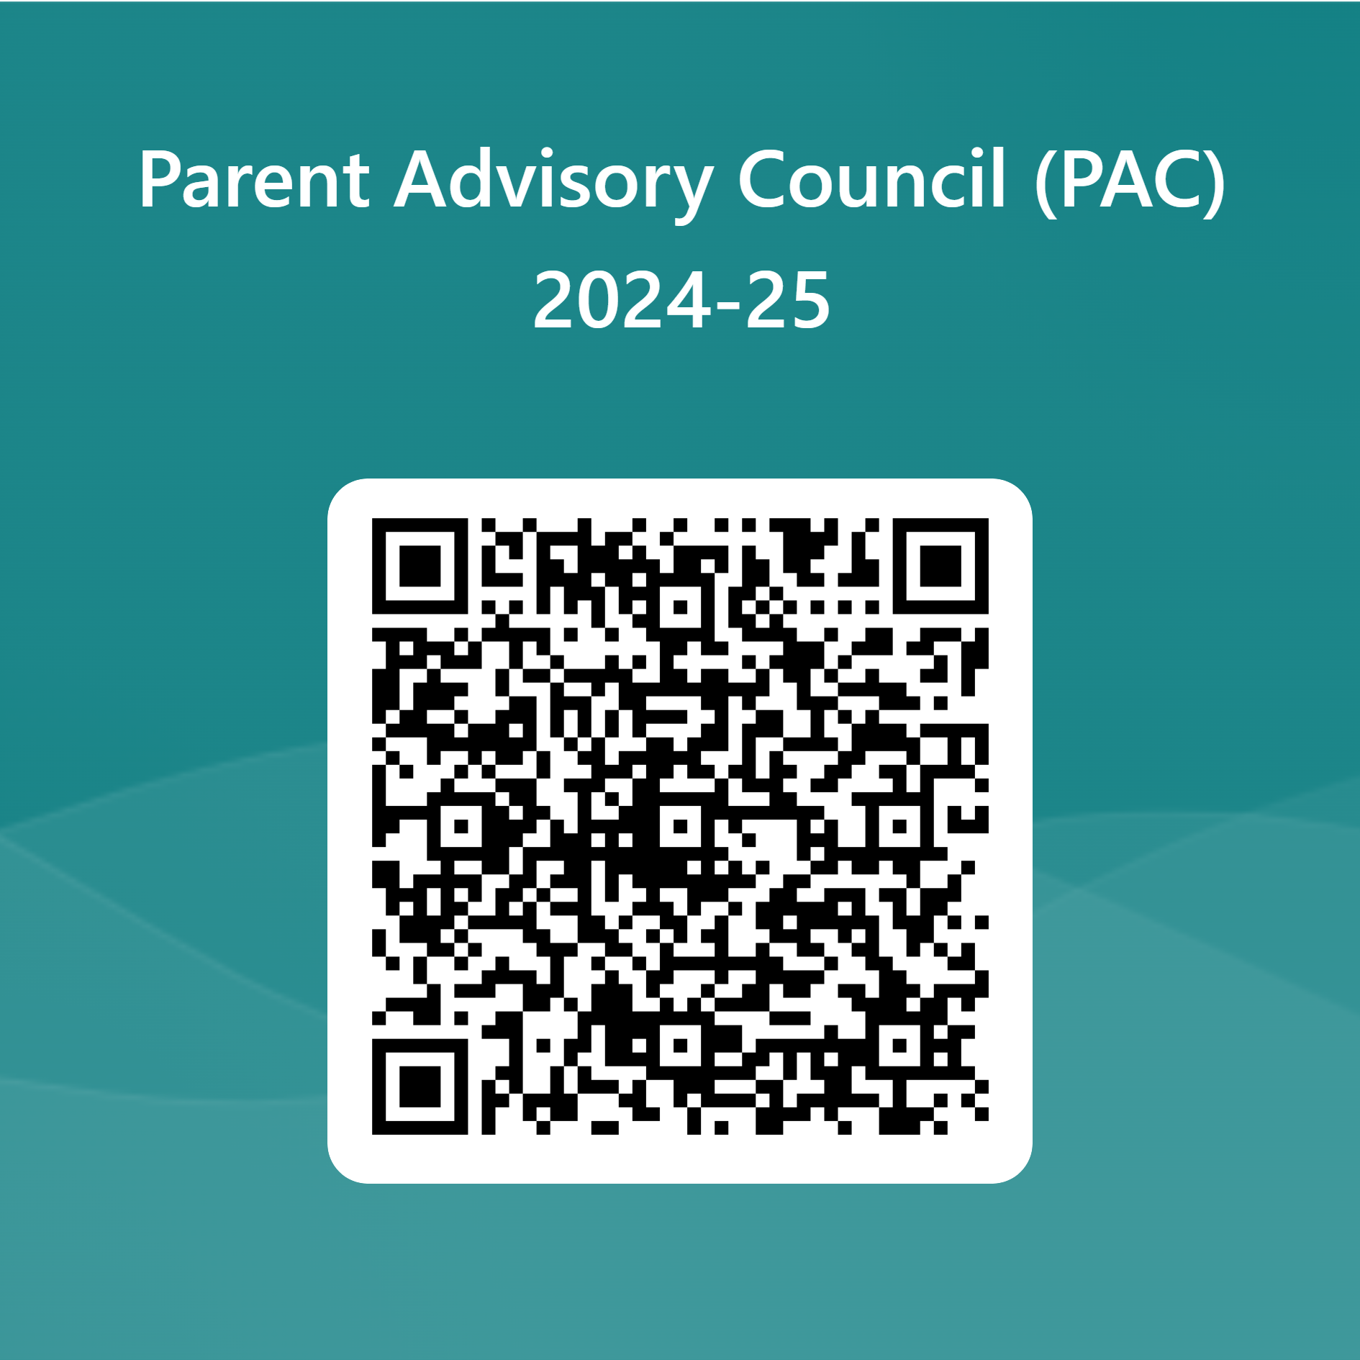

Parent Advisory Council (PAC)
The District has a Parent and Family Engagement Plan. The summary of the plan is in the Title I School & Family Partnership Overview.
You may access the full plan at www.pcsb.org/titleone
The Parent Advisory Council (PAC) is responsible for reviewing and revising the District PFEP.
PAC will meet virtually or in person with the district’s Title I staff.
Each school is committed to having at least one member representative in PAC.
PAC meets twice a year, if you are interested in representing our school please notify, Ms V.
Notes:
Please add your PAC representative in slide and share with your Title I Specialist.
https://forms.office.com/r/r5daaMTENE\

Slide 13
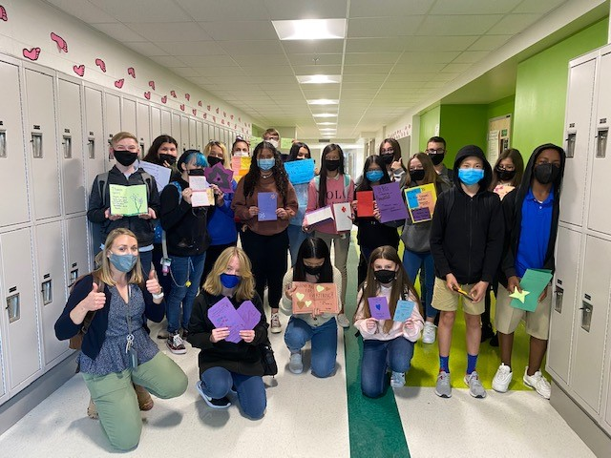

Additional Resources
Learning at Home Family Resources - https://www.pcsb.org/Page/32836
Volunteer in a Pinellas County School - https://www.pcsb.org/Page/459
Parent Academy POWER HOURS Webinars - https://www.pcsb.org/Page/26534
Partnerships - https://www.pcsb.org/Page/418

Slide 14
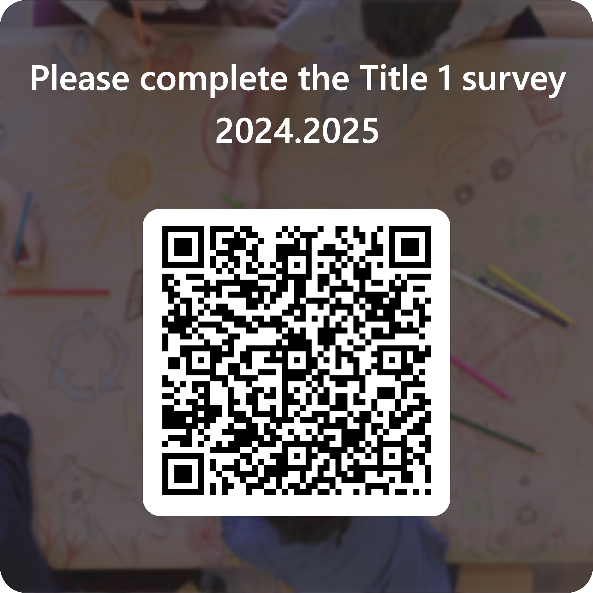
Please take the time to participate in our survey.
Thank you for coming!
Your feedback is greatly appreciated!
Notes:
Thank you so much for coming tonight and for your attention. We hope this information has been valuable to you and your family. Please take a few moments and complete the Title 1 survey, your feedback is greatly appreciated.
https://forms.office.com/Pages/ShareFormPage.aspx?id=BZM8c9c5GkaGb_3ye_PH_x-1YNVO6C1FkgA88U6PR2tUNEQzTU0wNkZXVUxVTlpEMU81NkJFMlJNTi4u&sharetoken=FXXhmgwFjSnl0sNz61ki

